Slide 1
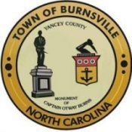
Yancey County, NC Comprehensive Transportation Plan
Draft Recommendations for Public Input
March 2021

Slide 2
Introduction
In March 2020, Yancey County, Burnsville, the High Country RPO, and the NCDOT began a collaborative effort to develop an update to the 2008 Yancey County Comprehensive Transportation Plan (CTP).
The recommendations described in this presentation have been developed to address the needs identified during the process. The CTP will be used to identify priority projects for funding and construction in future years.
Please review the following recommendations and then provide your input through the survey at http://tinyurl.com/Yancey-County-CTP or in person using comment sheets that can be found along with recommendation maps at the Burnsville Town Center between April 12-16 during operating hours.

Slide 3
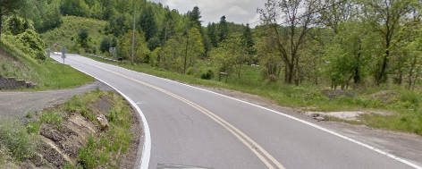
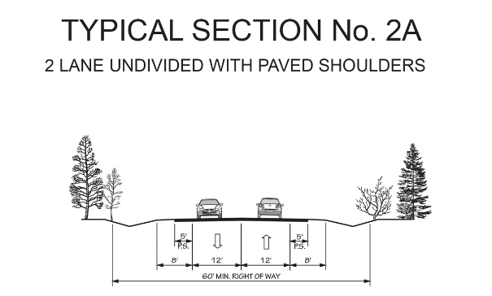
US 19W From US 19E to Little Creek Rd (SR 1411)
Need
Functionally classified as a Major Collector this facility has narrow 9 to 10-foot lanes with no paved shoulders.
This facility is scenic as it goes along the Cane River, and it connects to the Cherokee National Forest, the Appalachian Trail, and Tennessee. It is popular with recreational cyclists.
Recommendation
Modernize to 12-foot lanes to accommodate vehicular traffic with 5-foot paved shoulders to accommodate cyclists.
Public Comments Previously Received:
US 19W is a highly used and popular cycling route. A wider shoulder would significantly improve safety.
Primary secondary road needs widening or wider shoulders.

Slide 4
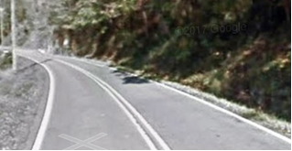
US 19W From Little Creek Rd (SR 1411) to Huntdale Rd (SR 1417)
Need
Functionally classified as a Major Collector this facility has narrow 9-foot lanes with no paved shoulders.
This facility is scenic as it goes along the Cane River and into the Cherokee National Forest and Tennessee. It is popular with recreational cyclists.
Recommendation
Modernize to 12-foot lanes to accommodate vehicular traffic with 5-foot paved shoulders to accommodate cyclists.
Public Comments Previously Received:
Cyclists are on this road all the time, need shoulder for safety.
People drive over the line all the time, especially big trucks. Drive too fast for the conditions.

Slide 5
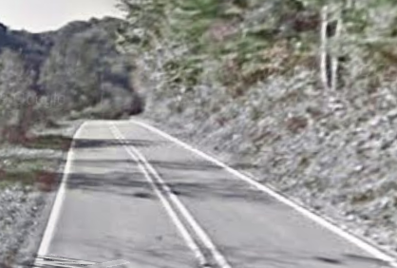
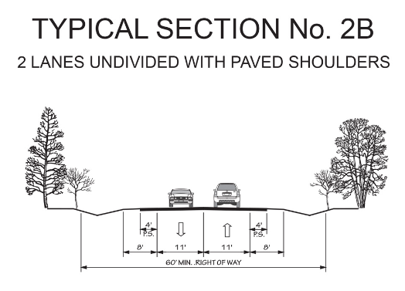
US 19W From Huntdale Rd (SR 1417) to Tennessee State Line
Need
Functionally classified as a Major Collector this facility has narrow 8-foot lanes with no paved shoulders.
This facility is scenic as it goes along the Cane River and into the Cherokee National Forest and Tennessee.
Recommendation
Modernize to 11-foot lanes to accommodate vehicular traffic with 4-foot paved shoulders.
Public Comments Previously Received:
Modernization of NC 80, NC 197 and US 19W will help to connect more remote sections of the county to US 19E.
Primary secondary road needs widening or wider shoulders.

Slide 6
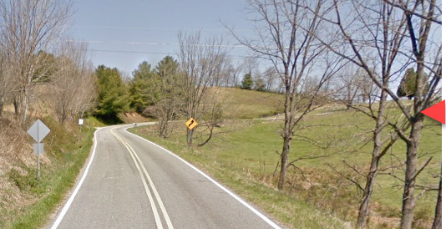
NC 80 From US 19E to Mitchell County line
Need
Functionally classified as a Major Collector this facility has narrow 9-foot lanes with no paved shoulders.
This facility links Yancey County and Mitchell County. It is popular with recreational cyclists.
Recommendation
Modernize to 12-foot lanes to accommodate vehicular traffic with 5-foot paved shoulders to accommodate cyclists.
Public Comments Previously Received:
NC 80 needs to be made safer. Wider and better shoulders.
Semi-trucks on this road take up both lanes when maneuvering around curves. It is unsafe for pedestrians, cyclists, and automobiles.

Slide 7
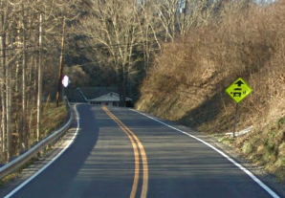
NC 80 From US 19E to Seven Mile Ridge Rd (SR 1167)
Need
Functionally classified as a Major Collector this facility has narrow 10-foot lanes with no paved shoulders.
This facility links Yancey County and McDowell County and provides access to the Blue Ridge Parkway. It is popular with recreational cyclists.
Recommendation
Modernize to 12-foot lanes to accommodate vehicular traffic with 5-foot paved shoulders to accommodate cyclists.
Public Comments Previously Received:
Around 30 comments received about the need to accommodate cyclists on NC 80 S were received.
NC 80S is heavily trafficked roads that are narrow and have dangerous shoulders.
Better shoulders, straighten, add left turn lanes.

Slide 8
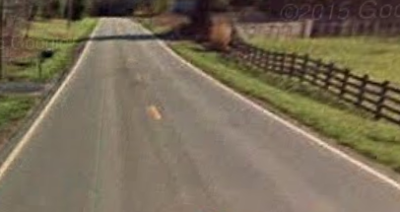
NC 80 From Seven Mile Ridge Rd (SR 1167) to South Toe River Rd (SR 1205)
Need
Functionally classified as a Major Collector this facility has narrow 10-foot lanes with no paved shoulders.
This facility links Yancey County and McDowell County and provides access to the Blue Ridge Parkway. It is popular with recreational cyclists.
Recommendation
Modernize to 12-foot lanes to accommodate vehicular traffic with 5-foot paved shoulders to accommodate cyclists.
Public Comments Previously Received:
Intersection improvements to the NC 80 and South Toe Elementary School Road intersection

Slide 9
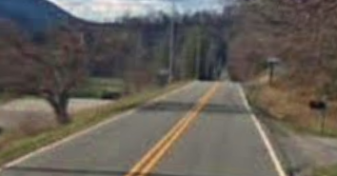
NC 80 From South Toe River Rd (SR 1205) to McDowell County line
Need
Functionally classified as a Major Collector this facility has narrow 9-10-foot lanes with no paved shoulders.
This facility links Yancey County and McDowell County and provides access to the Blue Ridge Parkway. It is popular with recreational cyclists.
Recommendation
Modernize to 12-foot lanes to accommodate vehicular traffic with 5-foot paved shoulders to accommodate cyclists.
Public Comments Previously Received:
I want to safely ride my bike on Hwy 80. There are many cyclists coming from the Blue Ridge Parkway, and there is so much potential to be a biking haven!
If Hwy 80 South is widened down to Hamrick and bike lane or bike path is installed, public health and safety in the South Toe Valley will be dramatically affected.

Slide 10
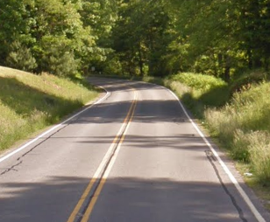
NC 197 From US 19E to Clearmont School Rd (SR 1416)
Need
Functionally classified as a Major Collector this facility has 11-foot lanes with no paved shoulders.
This facility links Yancey County and Mitchell County. It is popular with recreational cyclists.
Recommendation
Modernize to 12-foot lanes with climbing lanes to accommodate vehicular traffic with 5-foot paved shoulders to accommodate cyclists.
Public Comments Previously Received:
Need wider road on NC 197.
One of main routes going north needs bike lane or trail
Gravel trucks and bikes on the road
*With Climbing lanes

Slide 11
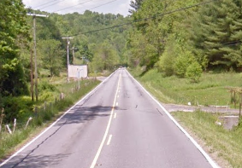
NC 197 From Clearmont School Rd (SR 1416) to NC 226 (Mitchell County)
Need
Functionally classified as a Major Collector this facility has 11-foot lanes with no paved shoulders.
This facility links Yancey County and Mitchell County. It is popular with recreational cyclists.
Recommendation
Modernize to 12-foot lanes with climbing lanes to accommodate vehicular traffic with 5-foot paved shoulders to accommodate cyclists. Climbing lanes should be considered to better minimize the impacts of truck traffic.
Public Comments Previously Received:
Gravel trucks and bikes on the road
Need wider road on NC 197.
NC 197N is heavily trafficked road that is narrow and has dangerous shoulders. Make wider with better shoulders.
*With Climbing lanes

Slide 12
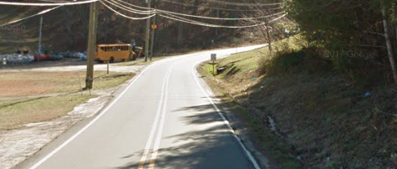
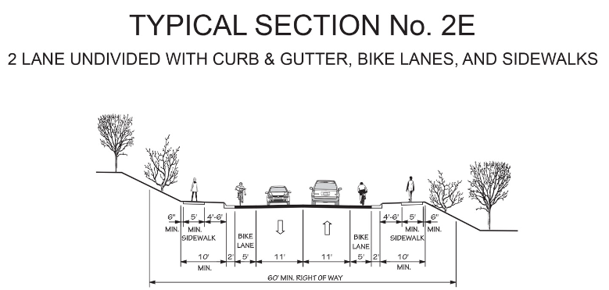
NC 197 From US 19E to Blue Ridge Ln
Need
Functionally classified as a Major Collector this facility has narrow 9-foot lanes with no paved shoulders.
This facility provides access to Yancey County Social Services. It is popular with recreational cyclists.
Recommendation
Modernize to 11-foot lanes to accommodate vehicular traffic with 5-foot bike lane and sidewalks.
Public Comments Previously Received:
Modernization of NC 80, NC 197, and US 19W will help to connect more remote sections of the county to US 19E.
Scenic bike route.

Slide 13
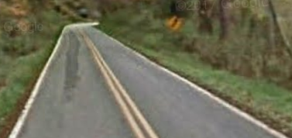
NC 197 From Blue Ridge Ln to Cattail Creek Rd (SR 1102)
Need
Functionally classified as a Major Collector this facility has narrow 9-foot lanes with no paved shoulders.
This facility links Yancey County and Buncombe County. It also provides access to Mount Mitchell State Park lands. It is popular with recreational cyclists.
Recommendation
Modernize to 12-foot lanes to accommodate vehicular traffic with 5-foot paved shoulders to accommodate cyclists.
Public Comments Previously Received:
Modernization of NC 80, NC 197, and US 19W will help to connect more remote sections of the county to US 19E.
Scenic bike route.

Slide 14
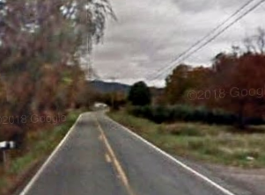
NC 197 From Cattail Creek Rd (SR 1102) to Ewart Wilson Rd (SR 1100)
Need
Functionally classified as a Major Collector this facility has narrow 9-foot lanes with no paved shoulders.
This facility links Yancey County and Buncombe County. It also provides access to Mount Mitchell State Park lands. It is popular with recreational cyclists.
Recommendation
Modernize to 11-foot lanes to accommodate vehicular traffic with 4-foot paved shoulders.
Public Comments Previously Received:
Scenic bike route.
Need wider road on NC 197.

Slide 15
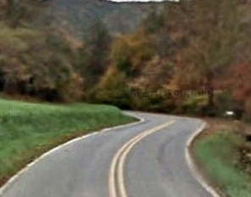
NC 197 From Ewart Wilson Rd (SR 1100) to Buncombe County line
Need
Functionally classified as a Major Collector this facility has narrow 9-foot lanes with no paved shoulders.
This facility links Yancey County and Buncombe County.
Recommendation
Modernize to 11-foot lanes to accommodate vehicular traffic. Bicycle accommodations were not recommended due to the low vehicular volumes along this section.
Public Comments Previously Received:
Need wider road on NC 197.
I feel that the posted speed limit (55 mph) on NC 197 is too high. There are many twists and turns, and frequently these turns have driveways.

Slide 16
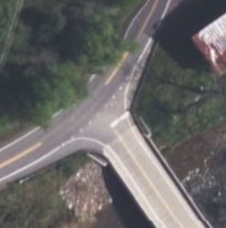
US 19W & Whittington Rd (SR 1379) Intersection
Public Comments Previously Received:
There are possible site distance issues at this intersection.

Slide 17
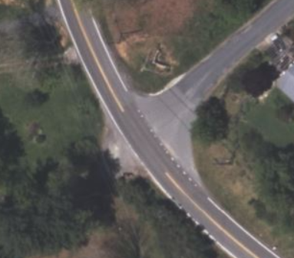
US 80 & South Toe School Rd (SR 1163) Intersection
Public Comments Previously Received:
Dangerous intersection of South Toe Elementary and Hwy 80,

Slide 18
Independent Bicycle Accommodations Recommendations
Road Name | From / To | Recommendation
NC 128 | Blue Ridge Pkwy to Dead End | 5 ft paved shoulders
Bolens Creek Rd (SR 1109) | NC 197 to NC 197 | 5 ft paved shoulders
Clearmont School Rd (SR 1416) | Jacks Creek Rd (SR 1336) to NC 197 | 5 ft paved shoulders
Coxes Creek Rd (SR 1354) | Jacks Creek Rd (SR 1336) to US 19W | 5 ft paved shoulders
Ferguson Hill Rd (SR 1429) | NC 197 to US 19E | 5 ft paved shoulders
Huntdale Rd (SR 1417) | US 19W to Huntdale Rd (SR 1340) bridge over North Toe River | 5 ft paved shoulders
Jacks Creek Rd (SR 1336) | US 19 E to Coxes Creek Rd (SR 1354) | 5 ft paved shoulders
Jacks Creek Rd (SR 1336) | Coxes Creek Rd (SR 1354) to Clearmont School Rd (SR 1416) | 5 ft paved shoulders
Toe River Rd (SR 1338) | Green Mountain Rd (SR 1338) to NC 197 | 5 ft paved shoulders
Roads Recommended for “Bicycle and Pedestrian Only” Improvements
Road Name | From / To | Recommendation
Pensacola Rd (SR 1429) | US 19 E to E Main St (SR 1428) | 5 ft bike lane and sidewalk

Slide 19
Roads Recommended for Sidewalk Improvements
Road Name | From/To | Recommendation
US 19E | West Burnsville Church Rd (SR 1375) to Charlie Brown Rd (SR 1438( | Add sidewalk along north side to traffic signal at Charlie Brown Rd for safer crossing of US 19E
Academy St | W Main St (SR 1428) to Glendale Ave | Add sidewalk along the west side
Azalea Ln | N Main St (SR 1369) to Summit Ave | Add sidewalk along the south side
Bennett St | E Main St (SR 1428) to Ramsey St | Add sidewalk
Bowditch St | Reservoir Rd to Sav-Mor Food | Add sidewalk along the west side
Celo St | Long View Rd to E Main St (SR 1428) | Add sidewalk
Cooper St | W Main St (SR 1428) to US 19E | Add sidewalk along the west side
Court St | West Blvd to W Main St (SR 1428) | Add sidewalk
East Blvd | Depot St (SR 1140) to US 19E | Add sidewalk
East Main St (SR 1428) | S Main St (SR 1428) to Dead End | Add sidewalk along the north side
Glendale Ave | Academy St to Swiss Ave | Add sidewalk
Hillside Dr | US 19E to W Main St (SR 1428) | Add sidewalk
Ivy St | East Blvd to E Main St (SR 1428) | Add sidewalk
Long View Rd | School Circle to E Main St (SR 1428) | Add sidewalk
Ramsey St | Bennett St to Long View Rd | Add sidewalk
Reservoir Rd | US 19E to Bowditch St | Add sidewalk along west side
Roberson St | W Main St (SR 1428) to W Glendale Ave | Add sidewalk
School Cir | Green Mountain Dr (SR 1369) to Parkway Playhouse | Add sidewalk along outer perimeter
Summit St | Azalea Ln to Green Mountain Dr (SR 1369) | Add sidewalk
Swiss Ave | Glendale Ave to W Main St (SR 1428) | Add sidewalk
West Blvd | Cooper St to S Main St (SR 1428) | Add sidewalk
West Glendale Ave | Clear View Ln (SR 1139) to Robertson St | Add sidewalk
West Main St (SR 1428) | Existing Sidewalk to US 19E | Add sidewalk along the north side
Westover Dr | W Main St (SR 1428) to US 19E | Add sidewalk along the east side

Slide 20
Recommended Greenways / Multi-Use Paths
Road Name | From / To | Recommendation
Cane River Greenway | Cane River Park/Whittington Rd (SR 1379) / Ferguson Hill Rd (SR 1139) | On new location following Cane River with access to Cane River Park, Cane River Middle School, Blue Ridge Elementary School, Mountain Heritage High School and Burnsville
Burnsville-Micaville Greenway | Georges Fork Rd (SR 1142) / Micaville Loop (SR 1186) | On new location connecting Burnsville to Micaville
South Toe River Greenway | US 19E/NC80 / Hickory Springs Rd (SR 1153) | On new location along NC 80
Observatory Greenway | US 19E/Wyatt Town Rd / Bare Dark Sky Observatory | On new location from US 19E to Bare Sky Observatory and future recreational areas along US 80N
Micaville Greenway | Micaville Loop / Observatory Greenway | On new location connecting Burnsville-Micaville Greenway to the Observatory Greenway
Other Recommendations:
Construct a new park and ride lot Near Depot St (SR 1140) and US 19E to serve Burnsville.
Crosswalk on US 19E near CVS/Roses.

Slide 21
Thank You!
Your input is crucial to planning in order to meet the future needs of Yancey County’s multi-modal transportation system.
If you have any other recommendations besides those listed in this presentation, please email them to either David Graham or Pam Cook (emails below).
High Country Rural Planning Organization (RPO)
David Graham, Transportation Planner
dgraham@hccog.org, (828) 265-5434 ext. 135
https://hccog.org/planning/#Transport
NCDOT Transportation Planning Division (TPD)
Pam R. Cook, PE, Project Engineer
prcook@ncdot.gov, (919) 707-0975
http://tinyurl.com/Yancey-County-CTP
https://connect.ncdot.gov/projects/planning/Pages/Comprehensive-Transportation-Plans.aspx

